Slide 1

Software Engineering Essentials
Build and Release Management
edX – Technical University of Munich

Slide 2
Build Management

Slide 3
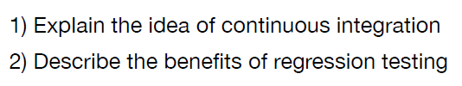
Learning Goals

Slide 4
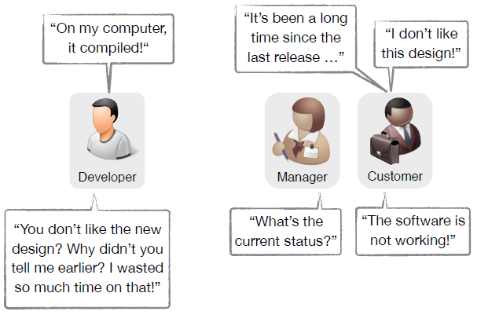
Typical situations in projects

Slide 5
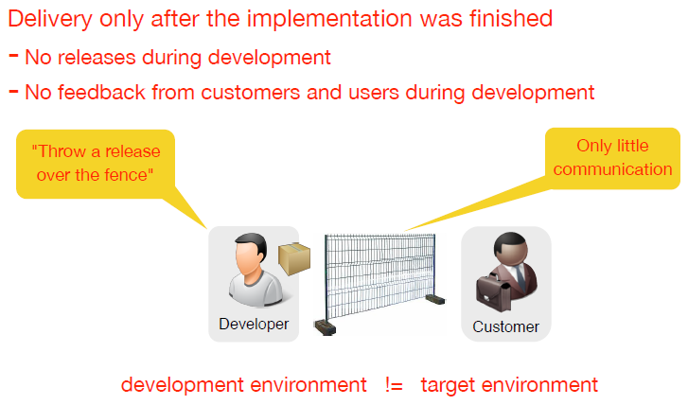
How it is still often done?

Slide 6
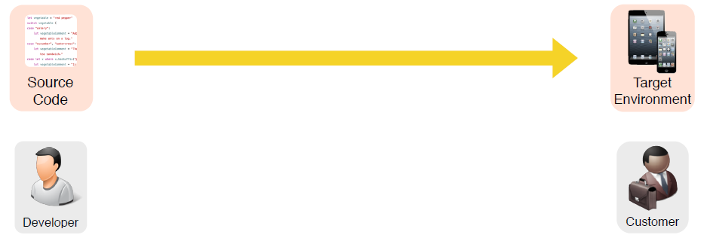
Objective: Release source code to devices in the target environment

Slide 7
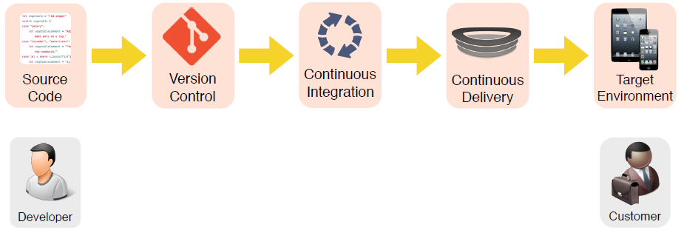
Build and release management overview

Slide 8
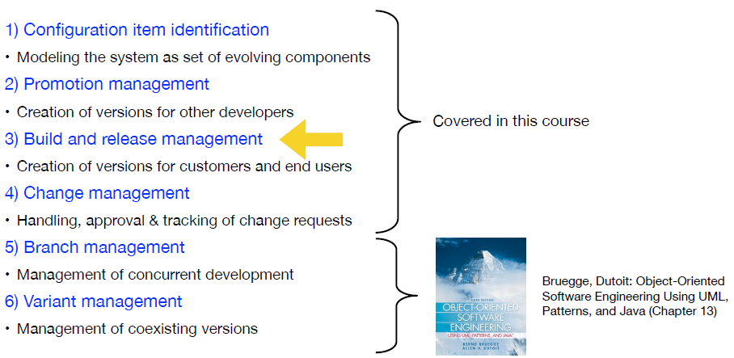
Review: software configuration management activities

Slide 9
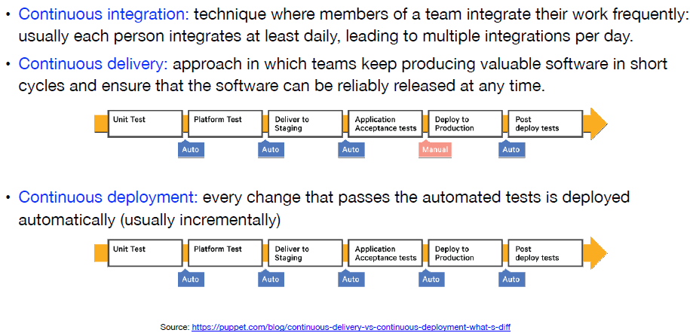
Terminology

Slide 10
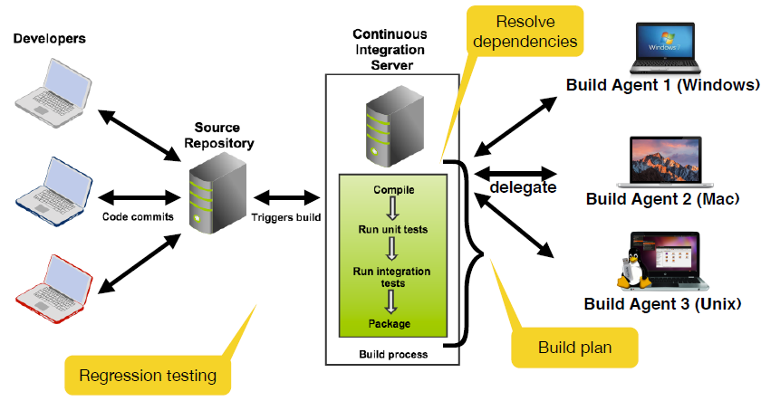
Build management with continuous integration

Slide 11

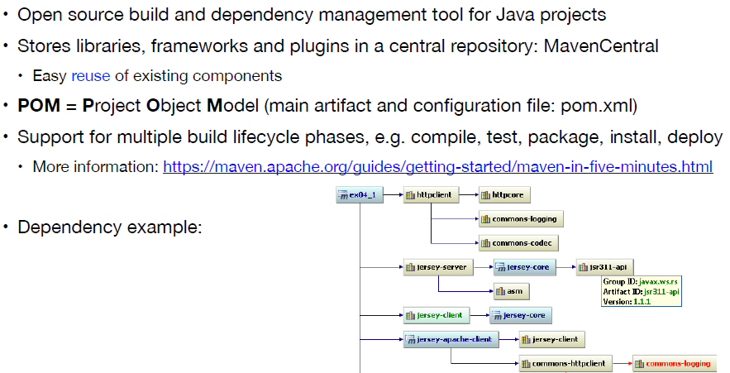
: build and dependency management tool

Slide 12
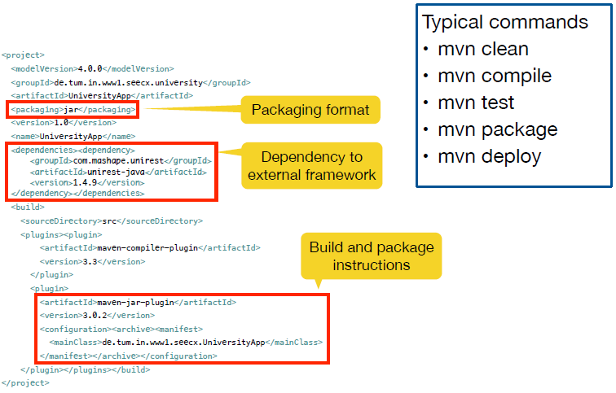
Example pom.xml

Slide 13
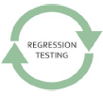
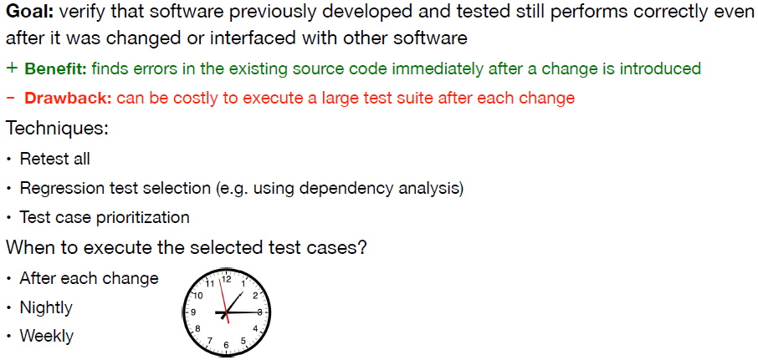
Regression testing

Slide 14
Release Management

Slide 15

Learning Goals

Slide 16
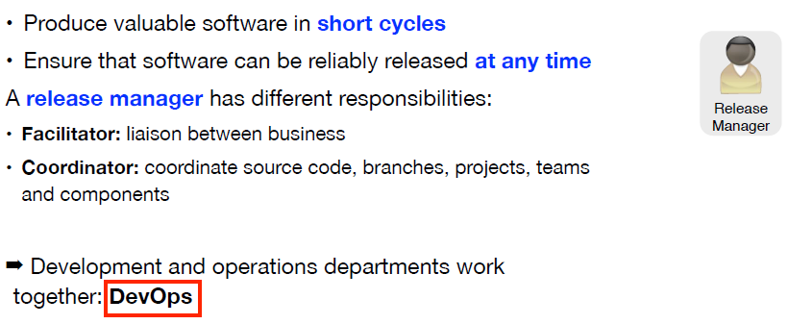
Release management

Slide 17
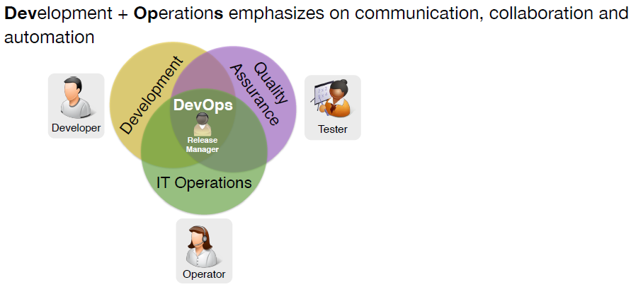
DevOps

Slide 18
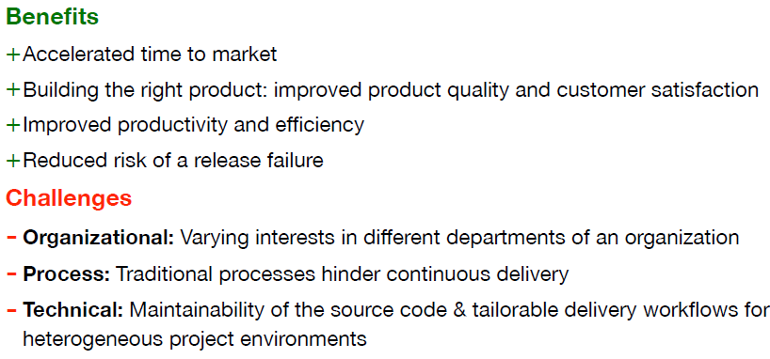
Continuous delivery: benefits and challenges

Slide 19
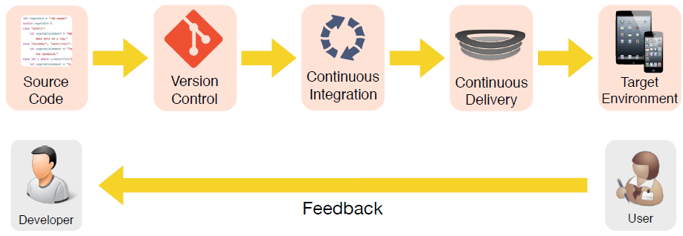
Release and feedback management

Slide 20
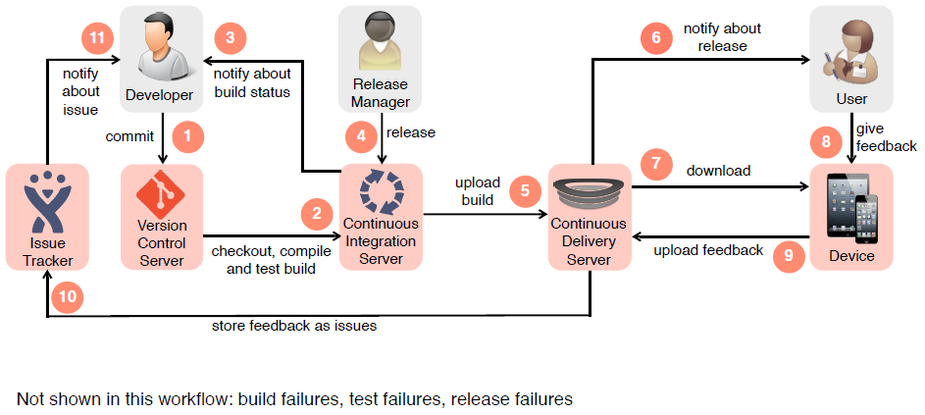
Example for a build and release management workflow with feedback

Slide 21
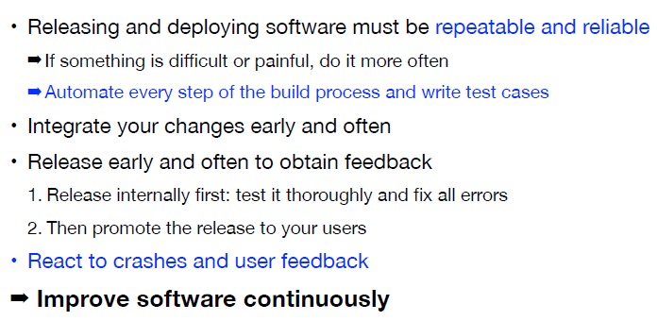
Best practices

Slide 22
Build and Release Management Exercise
In this exercise, you will configure the build and dependency management tool Maven for a given Java project. Therefore, you have to configure a pom.xml file.
Important: Make sure you have installed Java JDK Version > 1.8.0_65. Otherwise, the used UI Framework (JavaFX) will not work and you will get compile errors. You can check your Java Version using the terminal/cmd the command: java -version.
You have the following tasks in this exercise:
To get an overview of the exercise, we prepared for you a short video introduction. Check it out below.
Click on “Launch Exercise” below. You are redirected to ArTEMiS.
Click “Start Exercise”. The system will create a personal repository for you. This may take a minute. Please wait!
Use the “Clone Repository” button to clone your repository using SourceTree.
Import the project in Eclipse or your favorite IDE.

Slide 23
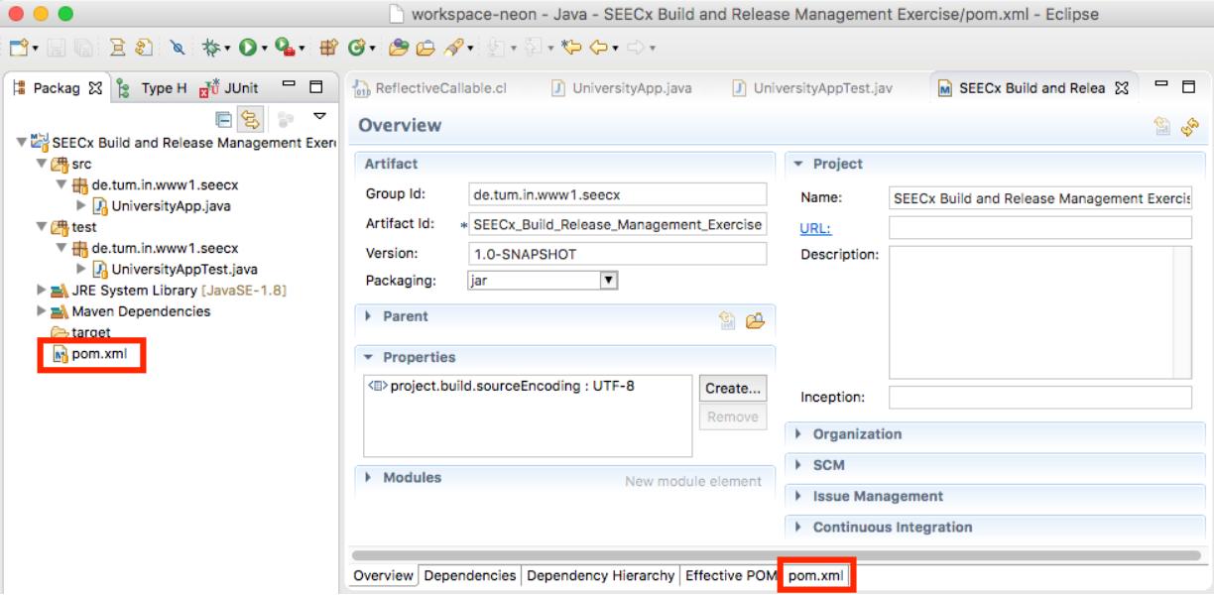
Build and Release Management Exercise
Run the UniversityApp (Right click "UniversityApp" --> Run As --> Java Application). You should see a window with one Button. (If this is not the case, you have a too old Java version. Please upgrade to the newest one!)
Configure Maven to run the tests (UniversityAppTest). Open the pom.xml and add the following line to the <build> section: <testSourceDirectory>${project.basedir}/test</testSourceDirectory> This tells Maven the directory of the test files. Note: Eclipse has a built-in pom.xml editor. To edit the raw pom.xml file, use the tab "pom.xml" as shown in the screenshot:

Slide 24
Build and Release Management Exercise
Execute the tests using Maven. Right-click on the Project (SEECx Build and Release Management Exercise) --> Run As --> Maven test. This will execute the command mvn test. You will see the output of Maven in the Console window of Eclipse and recognize that the test case in UniversityAppTest does not pass.
Fix the problem by changing the implementation of getButtonText() in UniversityApp. Have a look at the source code of UniversityAppTest to get the correct specification of the method. (This is one example of test driven development)
Note: Do not change the test case in UniversityAppTest!
Execute the test case again using Maven. Now you should get a BUILD SUCCESS message in the Console.
Create an executable application for potential end users. In Java, we can create an executable and distributable JAR file using Maven package.

Slide 25
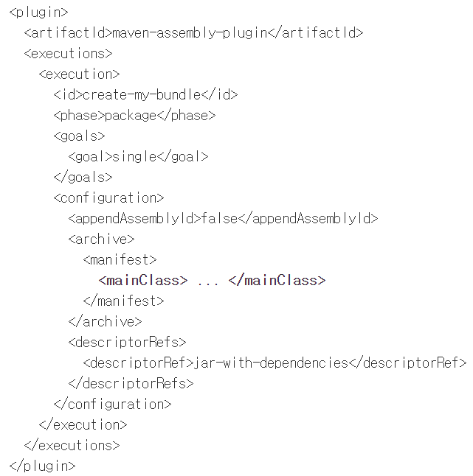
Build and Release Management Exercise
Edit the pom.xml again and add the following into the <plugins> section (within the <build> section):

Slide 26
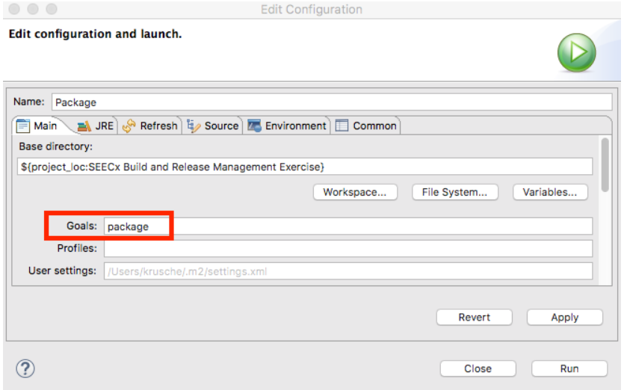
Build and Release Management Exercise
Configure the <mainClass> attribute correctly. (Hint: Have a look on slide 11 of the Build Management video).
Create the JAR file using mvn package. To execute the "package" goal in Eclipse, right-click the project --> Run As --> 2 Maven build... . Edit the configuration as shown in the screenshot below.

Slide 27
Build and Release Management Exercise
Have a look at the Console output. If everything works correctly, you should see Building jar: [...]/target/SEECx_Build_Release_Management_Exercise-1.0.jar in the log.
Execute the created JAR file (in the target directory) by double-clicking on it. The UniversityApp launches and you should see the window.
We want to add some Logging to the UniversityApp. To save time, we want to reuse an external component, the logging framework Log4j. Follow these instructions to add Log4j as external Maven dependency in the pom.xml file (starting at step 3 in the tutorial).
Do some reasonable logging within the UniversityApp class. Give out a log message using Log4j when the app starts.
Commit and push your code.
Our Build Server will run the Maven tasks (mvn test and mvn package).
Go to ArTEMiS. Check if all tests are passing.
Download the JAR file (created by the continuous integration server) using the link "Download Build Result".
Execute the file to check if everything worked correctly. (Depending on your operating system, you need to enable the execution of jar files)
Deliver this application to your users (e.g. your friends and colleagues)

Slide 28
Summary

Slide 29
Section 8 - Summary
Developing the software system is an important aspect of software engineering, but nevertheless the same importance is its delivery to customers and end users. During Week 8, you learned about Build and Release Management and how to integrate it in your software engineering project. You should take care of it early in your project!
The traditional way of delivering software to the customers includes only few releases at the end of the development, thus only few feedback is acquired from the customer and the software is not tested in its target environment. This is a bad approach and should NOT be used in software engineering projects! The process of releasing the software to the customer should start early and should be continuous. The following diagram describes an overview of the Build and Release process and the required concepts. In one sentence: Source code changes are stored using version control, integrated using continuous integration into a software which is released using continuous delivery into the target environment, so that users can provide feedback to developers.

Slide 30
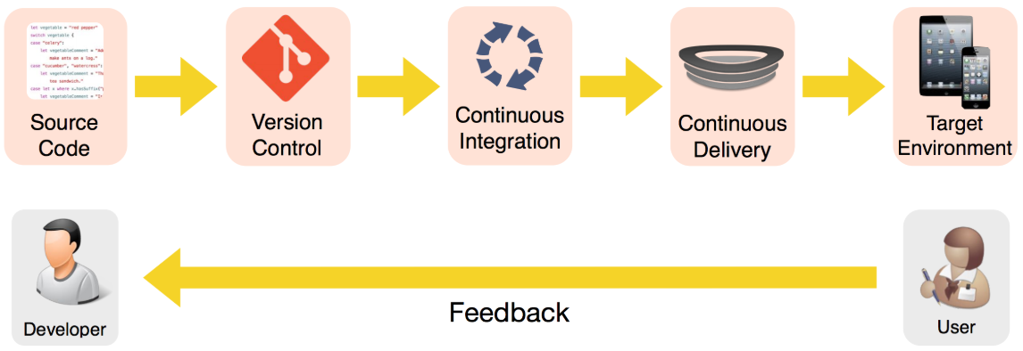
Section 8 - Summary
Build and Release Management includes 3 similar, but slightly different terms: Continuous Integration, Continuous Delivery, and Continuous Deployment. Continuous integration is the approach which you can use to collaborate with your developers team to integrate and test the work frequently. Continuous delivery allows to reliably release the current state of the software at any time. Continuous deployment is similar to continuous delivery with the only change that the deployment process is completely automatic. In continuous delivery, the deployment is a manual process, which should be controlled by the team, while in continuous deployment this process happens automatically if all automated tests pass successfully.

Slide 31
Section 8 - Summary
Automated testing (regression testing) should be integrated in the Build and Release process, allowing to easily identify any problems caused by the source code changes of the developers. Having an automated test suite reduces the time spent to manually find issues and bugs in the code and at the same time it ensures that every release is functional and with no errors. One of the issues of using regression testing is that a lot of time and computational effort is required to execute the test suite (especially if there are a lot of test cases in the suite). There are several techniques to deal with this issue, as you have seen during this week.
The following scheme represents an example of the Build and Release management process with all the steps defined. As you may have noticed during this course, customer feedback is necessary to achieve a good software quality and to avoid client non-acceptance of the delivered software (release failure). The approach of using the described build and release management allows to acquire continuous feedback from the customer and implement it to improve your product. Additionally, it allows continuous testing of your software system in the target environment. There are several best practices that you should keep in mind when using this approach in your software engineering undertaking!

Slide 32
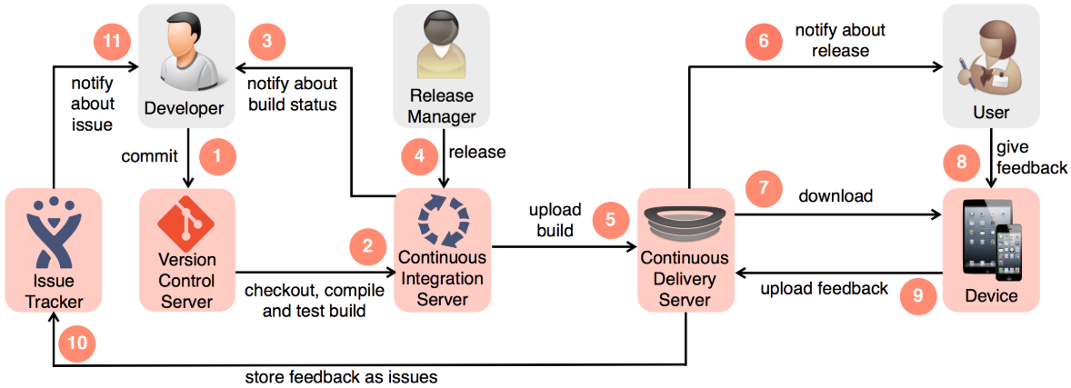
Section 8 - Summary
Finally, as this is the final week of our journey in the world of Software Engineering, you have seen a summary of the most important concepts covered during this course. This summary provides a full picture of a software engineering project and the best approaches how to handle and manage it. We hope you have enjoyed this experience and have acquired valuable skills and knowledge applicable in the field of software engineering!

Slide 33
Course Summary

Slide 34
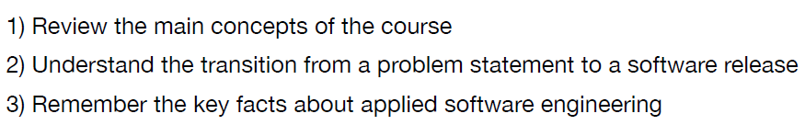
Learning Goal

Slide 35
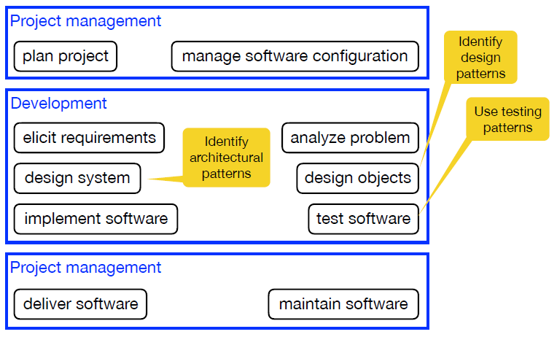
Main software engineering activities

Slide 36
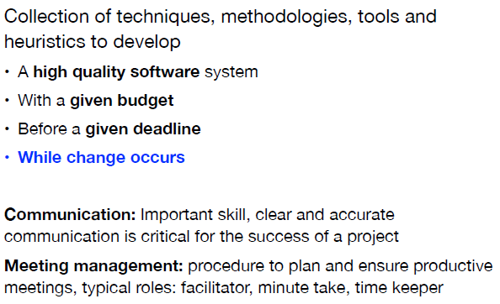
Project management and communication

Slide 37
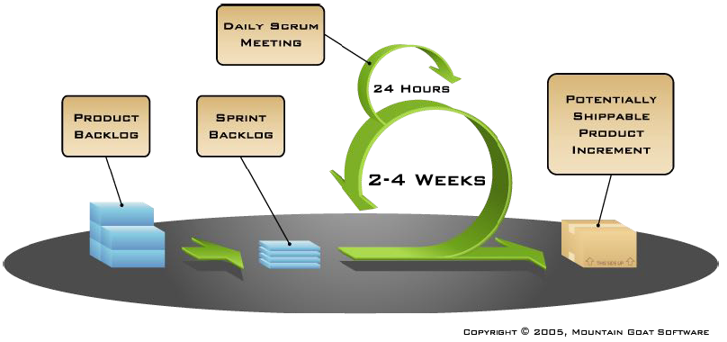
Agile methods

Slide 38
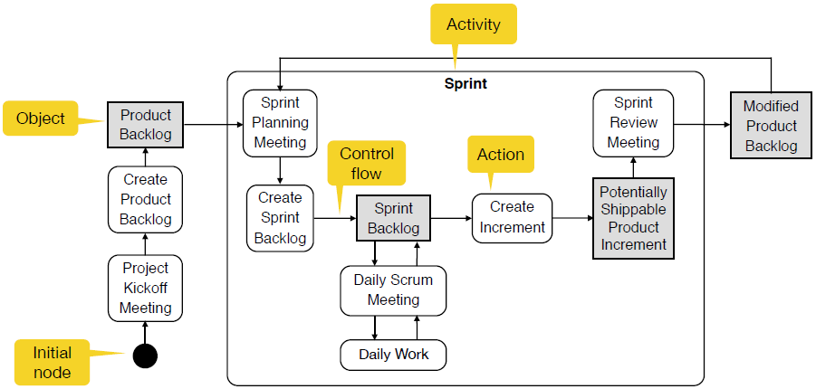
UML activity diagram

Slide 39
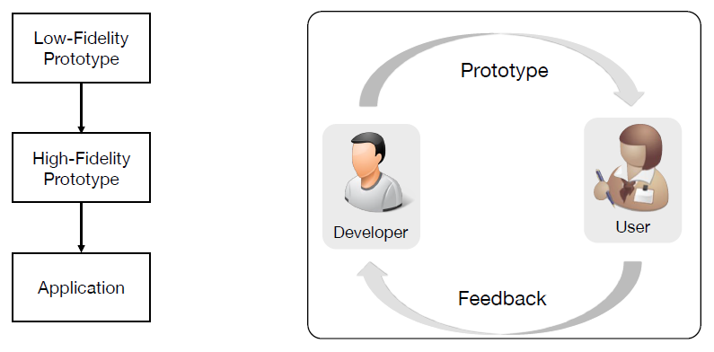
Prototyping: an iterative approach

Slide 40
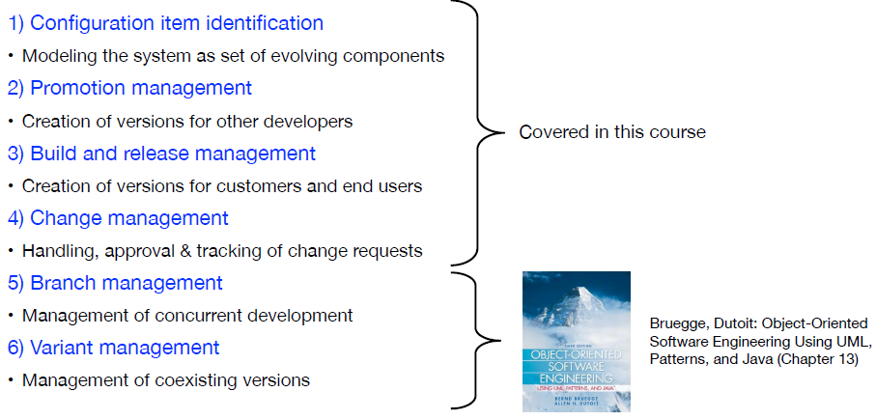
Software configuration management

Slide 41
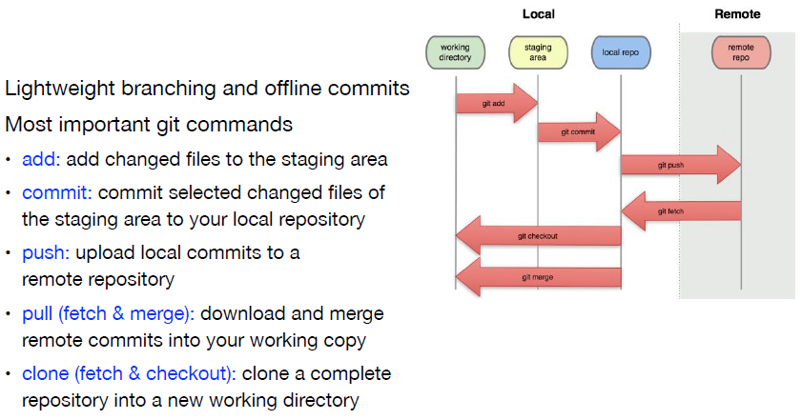
Distributed version control

Slide 42
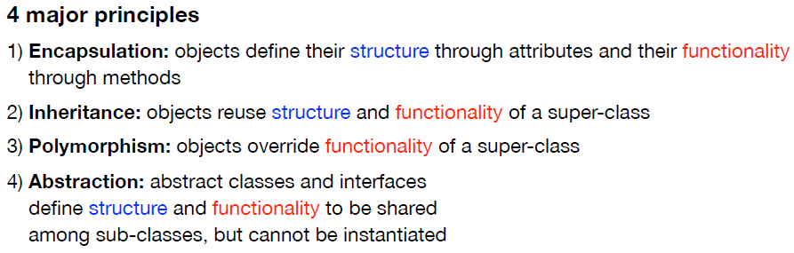
Object oriented programming

Slide 43
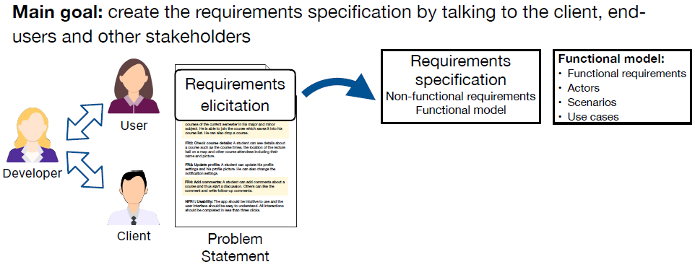
Requirements elicitation

Slide 44
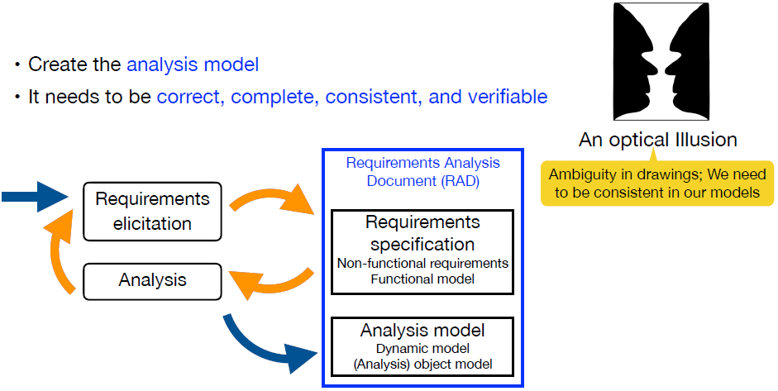
Analysis

Slide 45
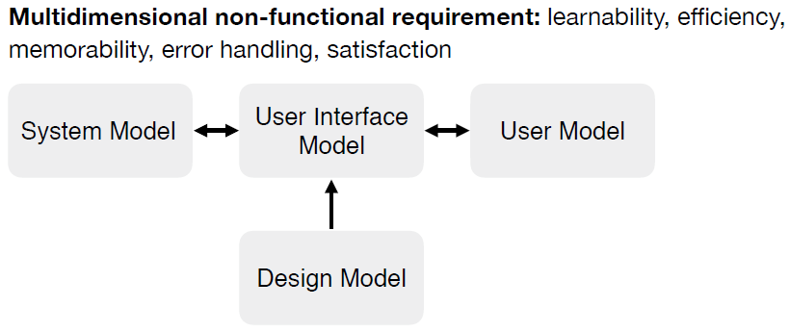
Usability

Slide 46
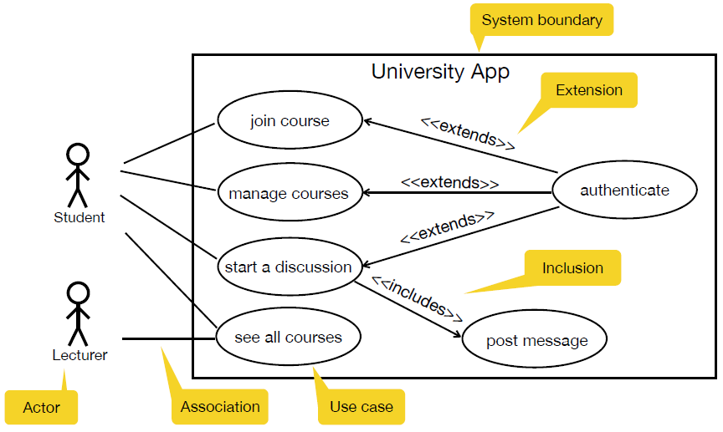
UML use case diagram

Slide 47
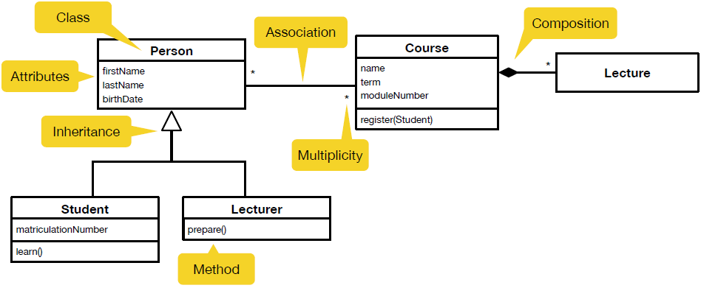
Analysis object model (UML class diagram)

Slide 48
Analysis object model (UML class diagram)

Slide 49
Learning Goal

Slide 50
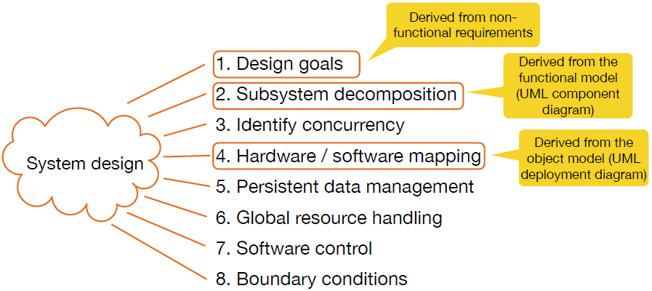
System design

Slide 51
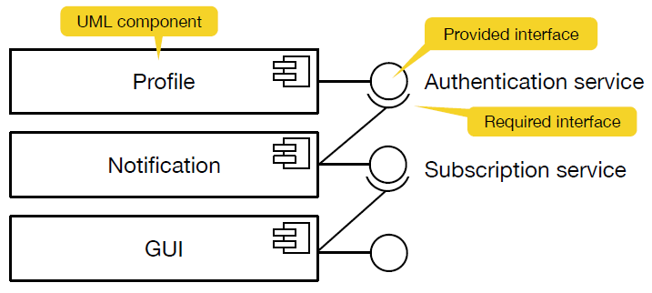
UML component diagram

Slide 52
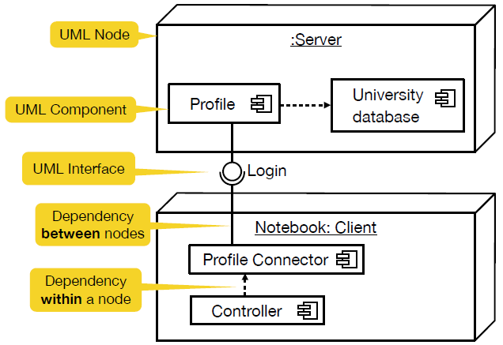
UML deployment diagram

Slide 53
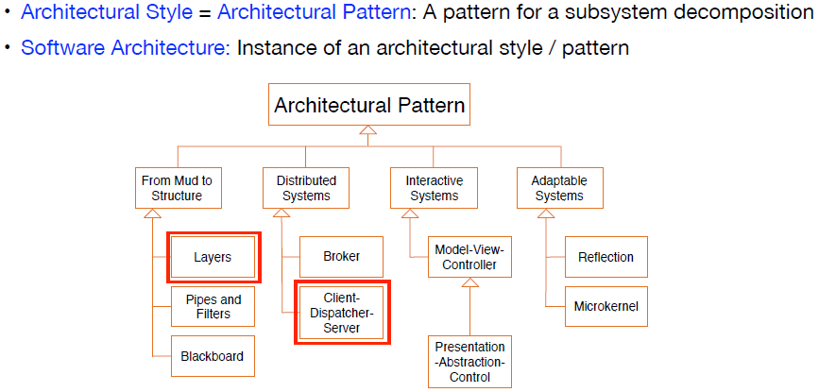
Architectural patterns

Slide 54
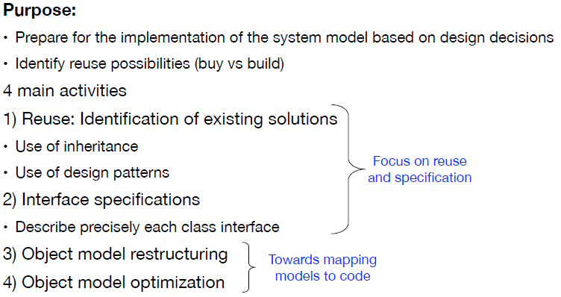
Object design

Slide 55
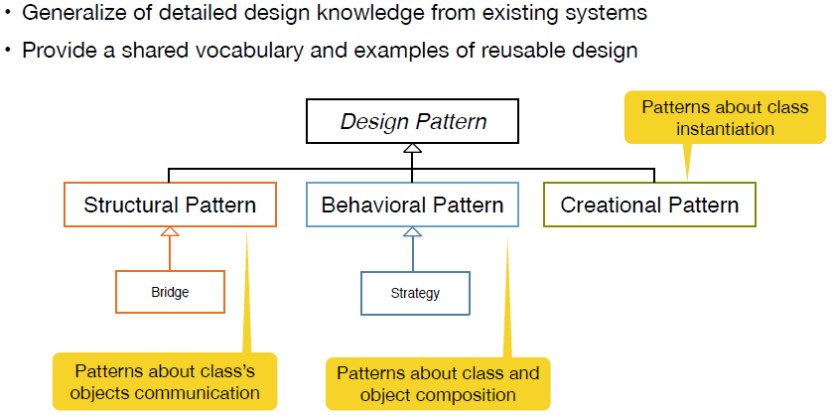
Design patterns

Slide 56
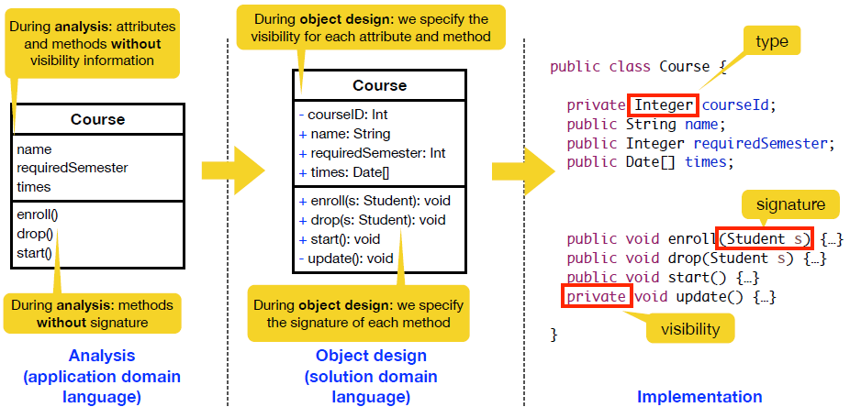
UML class diagram (object design)

Slide 57
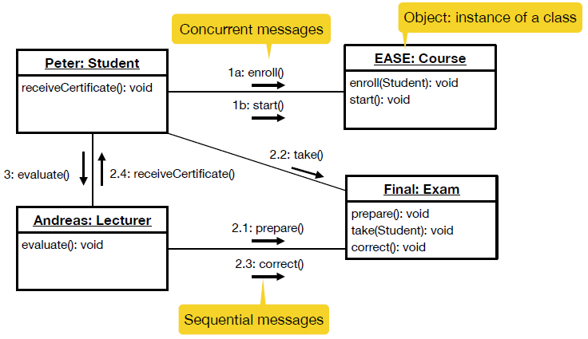
UML communication diagram

Slide 58
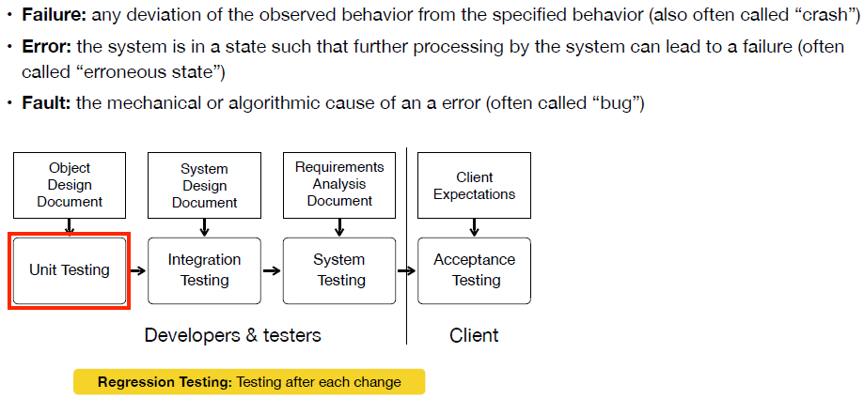
Testing

Slide 59
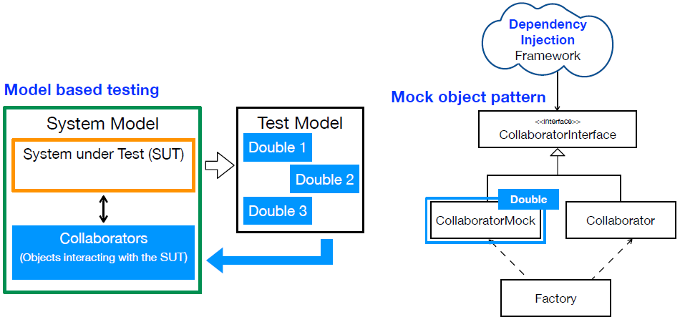
Testing patterns

Slide 60
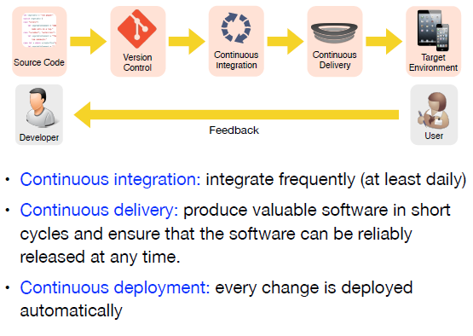
Build and release management

Slide 61
The End… ☺
Thank you !

